Slide 1
Agenda
Kubernetes Fundamentals
Introduction to Kubernetes
Docker Swarm vs. Kubernetes
Kubernetes Architecture
Configuring Kubernetes
YAML
Pod
Service
Deploy ASP.NET Core App to K8s

Slide 2
Introduction to Kubernetes
Kubernetes is an open-source container management (orchestration) tool.
Simplify container deployment, scaling of containers & container load balancing.
Kubernetes can run on-premises bare metal, OpenStack, public clouds Google, Azure, AWS, etc.
Note: Kubernetes is not a containerization platform. It is a multi-container management solution.
Notes:
Kubernetes for Windows
On April 1, 2019, the Kubernetes authors announced support for running Windows containers. To be specific, now when you run Kubernetes, you can attach it to Windows machines, which can then become “nodes,” making some of their memory, disk, and CPU available to run lightweight, virtual versions of Windows. The magic of Kubernetes is that you never really need to know where virtual hardware is.
The bad news is, your worker nodes in Kubernetes need to be running Windows Server 2019. The containers running in Kubernetes need to be running Windows Server 2019. You can run Kubernetes itself on Linux or Windows, but still–Server 2019.

Slide 3
Kubernetes Features
Automated Scheduling
Self-Healing Capabilities
Automated rollouts & rollback
Horizontal Scaling & Load Balancing
Offers enterprise-ready features
Application-centric management
Auto-scalable infrastructure

Slide 4
Kubernetes Disadvantages
Kubernetes can be an overkill for simple applications
Kubernetes is very complex and can reduce productivity
The transition to Kubernetes can be complicated

Slide 5
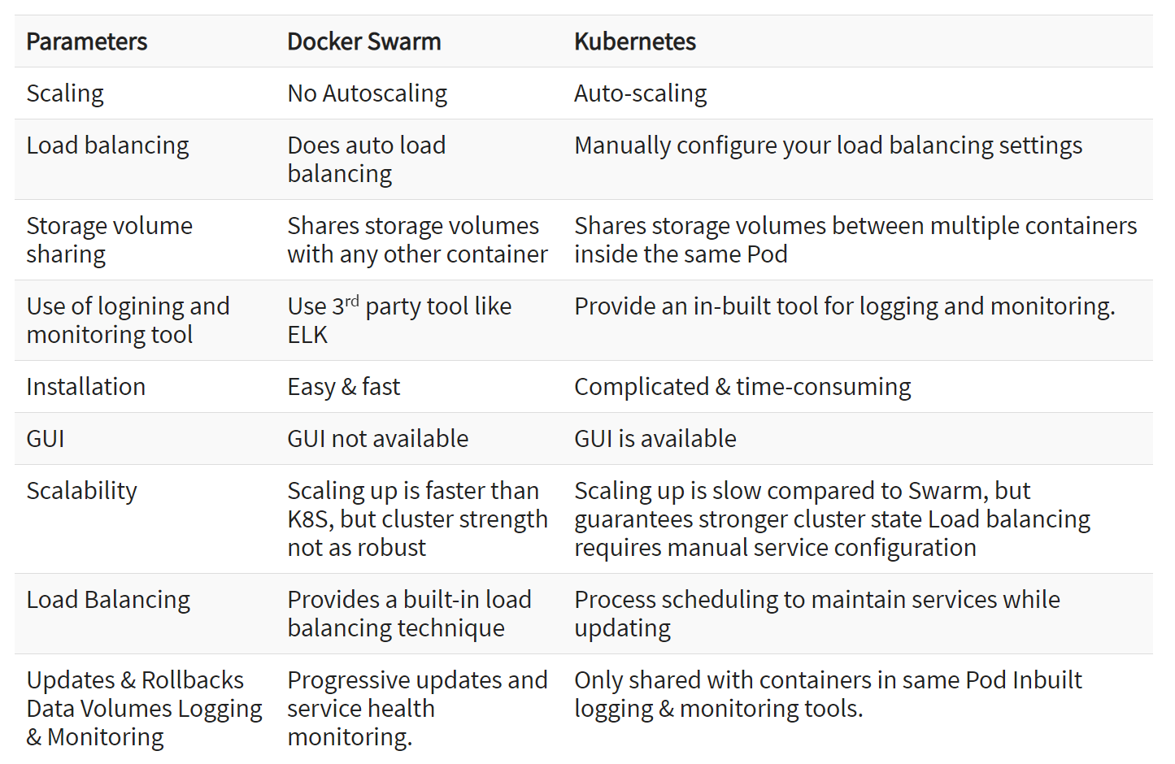
Docker Swarm vs. Kubernetes
Notes:
Docker is like a bus, and Kubernetes is like a bus station.
https://www.knowledgehut.com/blog/devops/kubernetes-vs-docker

Slide 6
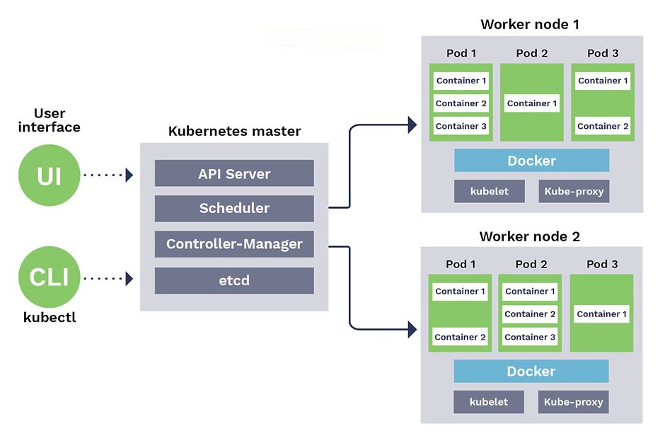
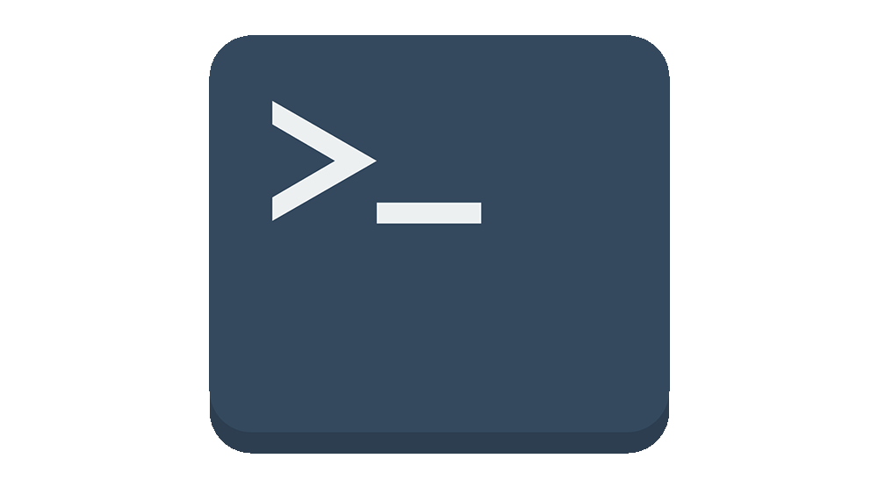
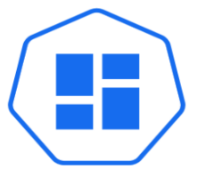
Kubernetes Architecture
Worker Node1
Pod
Pod
container1
container1
container2
Master Node
Container Runtime - Docker
API Server
kubelet
kube-proxy
kubectl
Scheduler
Worker Node2
Controller-Manager
Pod
Pod
etcd
container1
UI
container1
container2
Container Runtime - Docker
kubelet
kube-proxy
Notes:
https://platform9.com/blog/kubernetes-enterprise-chapter-2-kubernetes-architecture-concepts/
https://blog.sensu.io/how-kubernetes-works
https://thenewstack.io/kubernetes-an-overview/
Node – a machine running in the cluster.
Pod – smallest deployable unit, may have 1+ containers.
ReplicaSet – defines number of running instances of a pod.
Service – defines access to one or more workload API (types: ClusterIP, NodePort & LoadBalancer) sub-objects: svc, endpoint, iptables and IPVS.
Volume – storage of a container (supporting stateful workloads) sub-objects: PV and PVC and StorageClass.
Namespace – resources grouping.
Deployment – declarative packaging of a set of pods and services.
DaemonSet – run a pod instance on all nodes.
StatefulSet – manages Pods that are based on stateful workloads.
Job – creates one or more Pods / service.
Ingress – manages external access to the services in a cluster.

Slide 7
Kubernetes Architecture
Worker Node
Master Node
Pod
Pod
kube-apiserver
container1
container1
container2
kube-scheduler
Container Runtime Interface
kube-controller-manager
kubelet
kube-proxy
etcd
kube DNS
cloud-controller-manager
Notes:
https://platform9.com/blog/kubernetes-enterprise-chapter-2-kubernetes-architecture-concepts/
https://blog.sensu.io/how-kubernetes-works
https://thenewstack.io/kubernetes-an-overview/
Node – a machine running in the cluster.
Pod – smallest deployable unit, may have 1+ containers.
ReplicaSet – defines number of running instances of a pod.
Service – defines access to one or more workload API (types: ClusterIP, NodePort & LoadBalancer) sub-objects: svc, endpoint, iptables and IPVS.
Volume – storage of a container (supporting stateful workloads) sub-objects: PV and PVC and StorageClass.
Namespace – resources grouping.
Deployment – declarative packaging of a set of pods and services.
DaemonSet – run a pod instance on all nodes.
StatefulSet – manages Pods that are based on stateful workloads.
Job – creates one or more Pods / service.
Ingress – manages external access to the services in a cluster.

Slide 8
Master Node Components
API Server - The API server exposes a REST interface to the Kubernetes cluster. All operations against pods, services, and so forth, are executed programmatically by communicating with the endpoints provided by it.
Scheduler - The scheduler is responsible for assigning work to the various nodes. It keeps watch over the resource capacity and ensures that a worker node’s performance is within an appropriate threshold.
Controller manager - The controller-manager is responsible for making sure that the shared state of the cluster is operating as expected.
Etcd - A distributed key-value store that Kubernetes uses to share information about the overall state of a cluster. The master queries etcd to retrieve various parameters of the state of the nodes, pods and containers.

Slide 9
Worker Node Components
Kubelet: gets the configuration of a Pod from the API server and ensures that the described containers are up and running.
Container Engine/Runtime: Responsible for container management like pulling images, starting/stopping containers. Usually Docker is used for container runtime.
Kube-proxy: Kube-proxy acts as a load balancer and network proxy to perform service on a single worker node
Pods: A pod is a combination of single or multiple containers that logically run together on nodes

Slide 10
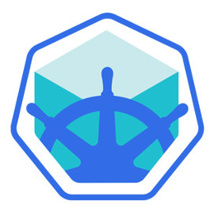
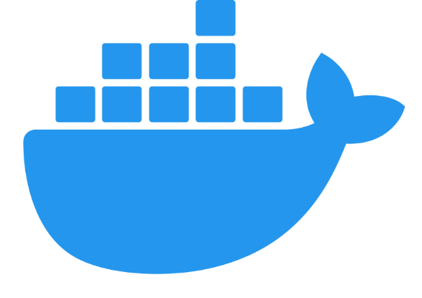
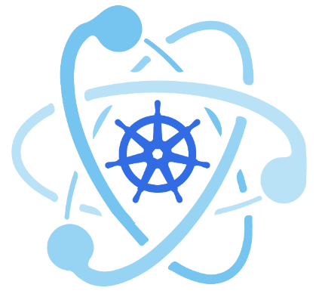
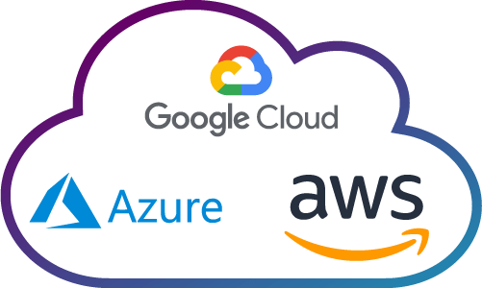
Configure Kubernetes
Minikube
Docker Desktop(Kubeadm)
Kubeadm
Cloud
Single Node Cluster
Multi Node Cluster

Slide 11


Single Node Cluster
API Server
kubectl
Scheduler
Controller-Manager
etcd
UI
Pod
Pod
container1
container1
container2
Container Runtime - Docker
kubelet
kube-proxy

Slide 12
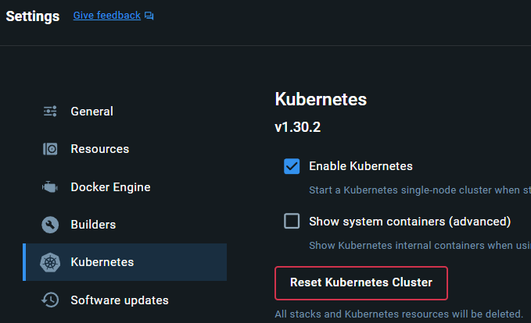
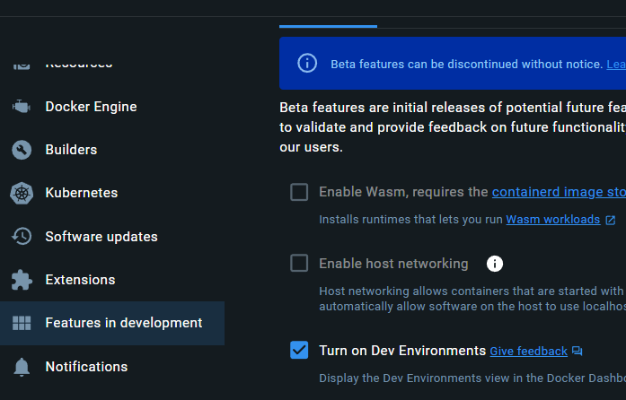
Kubernetes Using Docker Desktop

Slide 13
Verify Kubernetes Setup
> kubectl help
> kubectl get nodes
> kubectl cluster-info
> kubectl config get-clusters
> kubectl config get-contexts
> kubectl config view
> kubectl config use-context docker-desktop

Slide 14
Configure Kubernetes Dashboard
> kubectl version --output=json
> kubectl apply -f https://raw.githubusercontent.com/kubernetes/dashboard/v2.7.0/aio/deploy/recommended.yaml
> kubectl proxy
- Check Config file here= C:\Users\<user>\.kube\config
- To Access dashboard run the above command
> kubectl create serviceaccount dashboard-admin-sa
> kubectl create clusterrolebinding dashboard-admin-sa --clusterrole=cluster-admin --serviceaccount=default:dashboard-admin-sa
Notes:
The Ultimate Guide to the Kubernetes Dashboard: How to Install, Access, Authenticate and Add Heapster Metrics (replex.io)
C:\Users\<user>\.kube\config

Slide 15
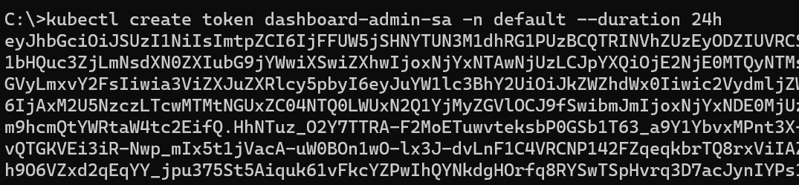
Accessing Kubernetes Dashboard
> kubectl proxy
- To Access dashboard run the above command and keep running
> kubectl create token dashboard-admin-sa -n default --duration 72h
- Copy the token and enter it into the token field on the following Kubernetes dashboard login page.
> K8s Dashboard Url: http://localhost:8001/api/v1/namespaces/kubernetes-dashboard/services/https:kubernetes-dashboard:/proxy/
Notes:
The Ultimate Guide to the Kubernetes Dashboard: How to Install, Access, Authenticate and Add Heapster Metrics (replex.io)
C:\Users\<user>\.kube\config

Slide 16
YAML
YAML is a human friendly data serialization standard for all programming languages.
Used for defining configuration or in an application where data is being stored or transmitted.
YAML is introduced in 2001.
Extension are .yml or .yaml
YAML is case sensitive.
YAML supports spaces instead of tabs.

Slide 17
XML vs. JSON vs. YAML
<Servers>
<Server>
<name>server1</name>
<location>india</location>
<status>active</status>
</Server>
</Servers>
{
"Servers": [
"Server": {
"name": "server1",
"location": "india",
"status": "active"
}
]
}
Servers:
- name: server1
location: india
status: active

Slide 18
YAML in Action
integer: 25
string1: name
string2: "name"
string3: 'name'
float: 25.0
boolean: true
name: server1
location: india
status: active
Servers:
- server1
- server2
- server3
Key/Value
Array/List: Ordered
Basic: Datatype
Servers:
name: server1
status: active
location: india
Servers:
- server1:
location: india
status: active
- server2:
location: usa
status: active
Dictionary/Map: Unordered
Array/Dictionary/Key-value

Slide 19
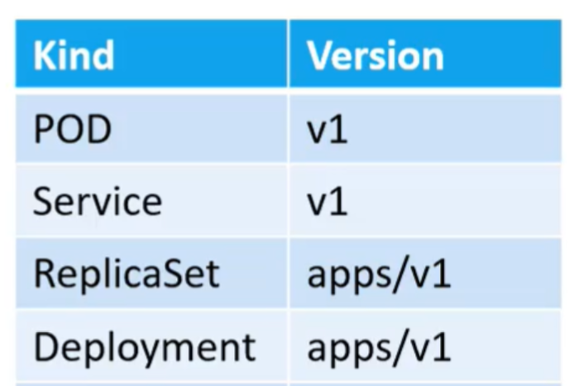
YAML in Kubernetes
apiVersion: v1
kind: Pod
metadata:
name: myapp-pod
labels:
name: myapp
spec:
containers:
- name: nginx-container
image: nginx

Slide 20
Pod
A logical container with one or more application containers and some shared resources (volumes).
Kubernetes uses pods to run your code and images in the cluster. Kubernetes works with Pods, rather than containers, so that containers in the same pod can be guaranteed to run on the same machine.
Containers in the same pod share their networking infrastructure, storage resources, and lifecycle.

Slide 21
Pod Commands
> kubectl run my-pod --image=nginx --port=8080
> kubectl apply -f pod.yaml
> kubectl get pods
> kubectl delete pod my-pod
> kubectl get pods --show-labels
apiVersion: v1
kind: Pod
metadata:
name: my-pod
labels:
app: web
spec:
containers:
- name: my-cont
image: nginx

Slide 22
Pod States
Pending: Pod has been created and accepted by the cluster, but one or more of its containers are not yet running.
Running: Pod has been bound to a node, and all of the containers have been created. At least one container is running, is in the process of starting, or is restarting.
Succeeded: All containers in the Pod have terminated successfully. Terminated Pods do not restart.
Failed: All containers in the Pod have terminated, and at least one container has terminated in failure.
Unknown: The state of the Pod cannot be determined.

Slide 23
Service
A Service enables network access to a set of Pods in Kubernetes.
Services select Pods based on their labels.
When a network request is made to the service, it selects all Pods in the cluster matching the service's selector, and forwards the network request to them.
Notes:
Pods - runs one or more closely related containers
Services - sets up networking in a Kubernetes cluster
Deployment - Maintains a set of identical pods, ensuring that they have the correct config and that the right number of them exist.
Pods:
Runs a single set of containers
Good for one-off dev purposes
Rarely used directly in production
Deployment:
Runs a set of identical pods
Monitors the state of each pod, updating as necessary
Good for dev
Good for production

Slide 24

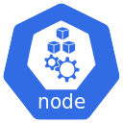
Service
10.2444.0.0
http://192.168.1.2:30008
Service
30008
10.244.0.2
Pod
container
192.168.1.2

Slide 25
Deploy ASP.NET Core App to Kubernetes
> docker build -t mvcapp:v1 .
> docker image ls
> kubectl apply -f pod.yml
> kubectl get pods
> kubectl delete -f pod.yml
> kubectl apply -f service.yml
> kubectl get services
> kubectl delete -f service.yml
# Step 1: Log in to Docker Hub
docker login
# Step 2: Tag your local image
docker tag webappdocker28sep:latest proshailendra/webappdocker28sep:latest
# Step 3: Push the image to Docker Hub
docker push proshailendra/webappdocker28sep:latest
Notes:
# Step 1: Log in to Docker Hub
docker login
# Step 2: Tag your local image
docker tag webappdocker28sep:latest proshailendra/webappdocker28sep:latest
# Step 3: Push the image to Docker Hub
docker push proshailendra/webappdocker28sep:latest

